Slide 1
Bloom’s Taxonomy & Sequential Logic
Bloom’s Taxonomy, Storing Data: The Bit, Representing and Building Memory, Program Counter (PC) Overview

Slide 2
Lecture Outline
Bloom’s Taxonomy
  Applying Higher Levels of Cognition to Learning
Storing Data: The Bit
  Bit Overview and Implementation
Representing and Building Memory
  Array Abstraction, Building From the Bit
Program Counter (PC) Overview
  Control Flow of Computer Programs

Slide 3
Bloom’s Taxonomy
Creating
Producing something new
Justifying your decisions or position
Evaluating
Drawing connections among ideas
Analyzing
Using information in a new (or similar) situation
Applying
Understanding
Explaining ideas or concepts
Remembering
Recalling facts and basic concepts

Slide 4
Bloom’s Taxonomy in Action: CSE 143
Creating
Creating your own Java objects in your CSE 143 assignments
Justifying why one would use a particular Java object (ArrayList)?
Evaluating
How do Java objects relate to other real-word tools?
Analyzing
Using Java objects defined in the standard class libraries
Applying
Understanding
Understanding the use Java objects
Remembering
Remembering what Java objects are

Slide 5
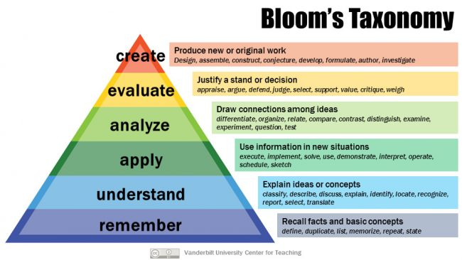
Bloom’s Taxonomy Discussion
In groups, discuss the following points:
Identify various aspects of your academic responsibilities as a UW student (e.g., attending lecture) and categorize them in one of the levels on Bloom’s Taxonomy
Discuss how you can practically engage in higher-order levels of thinking in Bloom’s Taxonomy

Slide 6
Lecture Outline
Bloom’s Taxonomy
  Applying Higher Levels of Cognition to Learning
Storing Data: The Bit
  Bit Overview and Implementation
Representing and Building Memory
  Array Abstraction, Building From the Bit
Program Counter (PC) Overview
  Control Flow of Computer Programs

Slide 7
Computer Overview
CPU is the “brain” of our computer
  Does necessary computations (add, subtract, multiply, etc.)
Memory is used to store values for later use
  Requires persistence across multiple computations
  Needs to change values at our discretion
COMPUTER
MEMORY
Data and instructions
CPU
Program Counter (which line of code should I execute)

Slide 8
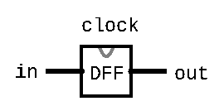
The Data Flip-Flop Gate
Simplest state-keeping component
  1-bit input, 1-bit output
  Wired to the clock signal
  Always outputs its previous input: out(t) = in(t-1)
Implementation: a gate that can flip between two stable states (remembering 0 vs. remembering 1)
  Gates with this behavior are “Data Flip Flops” (DFFs)

Slide 9
Aside: Treating the DFF as a Primitive
Disclaimer: DFFs can be made from Nand gates exclusively
  But requires wiring them together in a “messy” loop that the hardware simulator can’t simulate and isn’t very educational
For simplicity, we will treat the DFF as a primitive in the projects
  Just like Nand, you can use the built-in implementation

Slide 10
Data Flip-Flop (DFF) Behavior
1
Clock Signal
0
1
in
0
out
1
0
t=0
t=1
t=2
t=3
t=4

Slide 11
Sequential Chips
A category of chips that utilize the clock signal, in addition to any combinational logic
Capable of:
  Maintaining state
  Optionally, acting on that state and the current inputs
    Can incorporate combinational logic as well
Constructed from:
  DFFs
  Combinational logic (which is entirely constructed from Nand)

Slide 12
Sequential Chips
output(t) = f(state(t-1), input(t))
DFF
Combinational Logic
f
input
DFF
output
DFF

Slide 13
D Flip-Flop: Time Series
DFF Specification:
out(t) = in(t-1)
in | 0 | 0 | 1 | 1 | 0 | 1 | 0 | ...
out | 0 | 0 | 0 | 1 | 1 | 0 | 1 | ...
time | t=0 | t=1 | t=2 | t=3 | t=4 | t=5 | t=6 | ...
Example: out(t=3) = in(t=2)

Slide 14
Storing Data: The Bit
A Flip-Flop changes state every clock cycle
We will build the abstraction of a “Bit” that only changes when we instruct it to
load
Bit
in
out
if load(t-1) out(t) = in(t-1)
else out(t) = out(t-1)

Slide 15
Bit Behavior
1
load
0
1
in
0
out
1
0
t=0
t=1
t=2
t=3
t=4
load
if load(t-1) out(t) = in(t-1)
else out(t) = out(t-1)
Bit
out
in

Slide 16
Bit Behavior
1
load
0
1
in
0
out
1
0
t=0
t=1
t=2
t=3
t=4
load
if load(t-1) out(t) = in(t-1)
else out(t) = out(t-1)
Bit
out
in

Slide 17
Bit Time Series
if (load(t-1)): out(t) = in(t-1)
else: out(t) = out(t-1)
Bit Specification:
Example 1: load(t=0) == 1, so out(t=1) = in(t=0)
load | 1 | 0 | 0 | 1 | 1 | 1 | 0 | ...
in | 1 | 0 | 0 | 0 | 1 | 0 | 1 | ...
out | 0 | 1 | 1 | 1 | 0 | 1 | 0 | ...
time | t=0 | t=1 | t=2 | t=3 | t=4 | t=5 | t=6 | ...

Slide 18
Bit Time Series
if (load(t-1)): out(t) = in(t-1)
else: out(t) = out(t-1)
Bit Specification:
Example 1: load(t=0) == 1, so out(t=1) = in(t=0)
Example 2: load(t=2) == 0, so out(t=3) = out(t=2)
load | 1 | 0 | 0 | 1 | 1 | 1 | 0 | ...
in | 1 | 0 | 0 | 0 | 1 | 0 | 1 | ...
out | 0 | 1 | 1 | 1 | 0 | 1 | 0 | ...
time | t=0 | t=1 | t=2 | t=3 | t=4 | t=5 | t=6 | ...

Slide 19
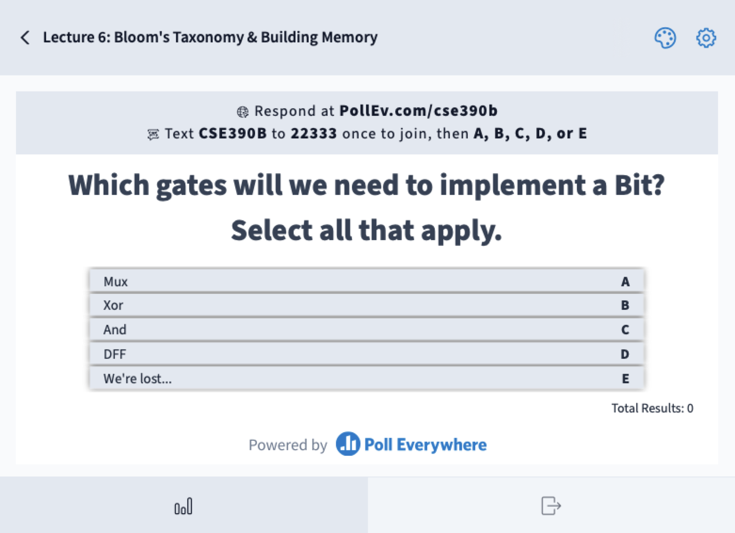
Which gates will we need to implement a Bit? Select all that apply.
Mux
Xor
And
DFF
We’re lost…
load
Bit
out
in
if load(t-1) out(t) = in(t-1)
else out(t) = out(t-1)

Slide 20
Implementing a Bit
if load(t-1) out(t) = in(t-1)
else out(t) = out(t-1)
Bit Specification:
Exercise: fill in the connections to the gates to create a circuit diagram of Bit

Slide 21
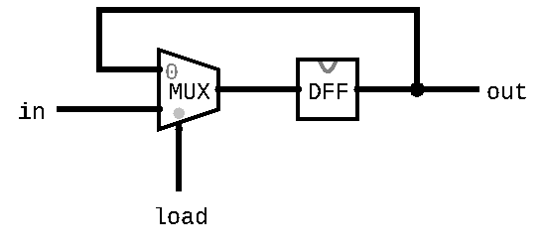
Implementing a Bit
if load(t-1) out(t) = in(t-1)
else out(t) = out(t-1)
Bit Specification:
Exercise: fill in the connections to the gates to create a circuit diagram of Bit

Slide 22
Lecture Outline
Bloom’s Taxonomy
  Applying Higher Levels of Cognition to Learning
Storing Data: The Bit
  Bit Overview and Implementation
Representing and Building Memory
  Array Abstraction, Building From the Bit
Program Counter (PC) Overview
  Control Flow of Computer Programs

Slide 23
Memory Representation
Memory can be abstracted as one huge array
Addresses are indices into different memory slots
  The width of an address is fixed for the system
  The nand2tetris project will use 16-bit addresses
Each value in memory takes up a fixed width
  Not the same as address width
  The nand2tetris project uses 16-bit slots (values) in memory

Slide 24
Memory Representation
Can read and write to memory by specifying an address
  More details next week
Example: x = memory[01...00]
  Reads the value in memory at address 01...00 and stores it in x
Example: memory[01...00] = 7
  Writes the value 7 in the memory slot at address 01...00

Slide 25
Building Memory: Register
Bits store a single value (0 or 1)
  In memory, we need to store 16-bit values
Registers are conceptually the same as a Bit
  Allows us to store and change 16-bit values
  Groups together 16 individual bits that share a load signal
// if (load(t-1)): out(t) = in(t-1)
// else: out(t) = out(t-1)
CHIP Register {
IN in[16], load;
OUT out[16];
...
}

Slide 26
RAM: Random Access Memory
Abstraction of Computer Memory: just a giant array
Goal: create hardware that can provide that abstraction
Key attribute of arrays: “random access” lets us index into them at any point
24 11000 | 25 11001 | 26 11010 | 27 11011 | 28 11100 | 29 11101 | 30 11110 | 31 11111
...
0 0000000 | 0 0000000 | -1 1111111 | 25 0011001 | 124 1111100 | 0 0000000 | 9 0001001 | -15 1110001
...
memory[26] = -1;

Slide 27
Building Memory: RAM8 From Registers
RAM interface:
  address: address used to specify memory slot
  in: 16-bit input used to update specified memory slot if load is 1
  load: if 1, then in should be written to specified memory slot
  out: 16-bit output from the slot specified by address
RAM8 can be built from 8 registers
  address width is log₂(8) = 3 bits
load
RAM8
in
out
0
Register
16
16
1
Register
address
...
n-1
Register
k

Slide 28
Building Memory: RAM8 From Registers
Step 1: Route in to every register
  We don’t want to update every register, however
  Solution: choose which register to enable with address
Step 2: Choose which register to use for the output
When we think about making choices in hardware, we want to think about Mux and DMux
load
RAM8
in
out
0
Register
16
16
1
Register
address
...
n-1
Register
k

Slide 29
Building Memory: The Rest of RAM
After RAM8, can build larger RAM chips from a combination of smaller RAM chips
  For example, RAM64 can be built using eight RAM8 chips
Technique is similar to RAM8 but will have to use different portions of the address
The blocks section of the reading will be helpful
  For example, can think of each RAM8 as a block of RAM64

Slide 30
Lecture Outline
Bloom’s Taxonomy
  Applying Higher Levels of Cognition to Learning
Storing Data: The Bit
  Bit Overview and Implementation
Representing and Building Memory
  Array Abstraction, Building From the Bit
Program Counter (PC) Overview
  Control Flow of Computer Programs

Slide 31
Program Counter (PC)
Memory is used to store data as well as code
Instructions and operations are stored at different addresses in memory
Program Counter in the CPU keeps track of which address contains the instruction that should be executed next
COMPUTER
MEMORY
Data and instructions
CPU
Program Counter (which line of code should I execute)

Slide 32
Program Counter (PC)
Keeps track of what instruction we are executing
  If the PC outputs 24, on the next clock cycle the computer runs the instruction at address 24 in the code segment
Program counter specification:
if (reset[t] == 1) out[t+1] = 0
else if (load[t] == 1) out[t+1] = in[t]
else if (inc[t] == 1) out[t+1] = out[t] + 1
else out[t+1] = out[t]
load
inc
reset
in
PC
out
16
16

Slide 33
Project 4 Overview
Part I: Cornell Note-taking
  Practice taking detailed notes in another class
  Think critically about the technique
Part II: Building Memory
  Memory & Sequential Logic: Build our first sequential chips, from a 1-bit register to a 16K RAM module
  Program Counter: Build counter that tracks where we are in a program, with support for several operations we’ll need later
  Note: Folder split for performance reasons only
Part III: Project 4 Reflection

Slide 34
Post-Lecture 6 Reminders
Project 3 due tonight (1/19) at 11:59pm
Project 4 (Cornell Note-taking & Building Memory) released today, due next Thursday (1/26) at 11:59pm
Eric has office hours after class in CSE2 153
  Feel free to post your questions on the Ed board as well

